Slide 1

Emotion Recognition
DEEP LEARNING WITH PYTORCH
Dikshit Chahal
1321085

Slide 2
AGENDA
  Introduction
  Problem Statement
  Dataset Description
  Methodology
  Model Architecture
  Training Process
  Results & Evaluation
  Visualization
  Conclusion
  Future Scope

Slide 3
INTRODUCTION
•Emotion recognition interprets human facial expressions
•Used in healthcare, security, HCI, and analytics
•Manual interpretation is inefficient and subjective
•Deep Learning provides automated and accurate solutions

Slide 4
PROBLEM STATEMENT
•Recognize human emotions from facial images
•Classify images into seven emotion categories
•Handle low-resolution and noisy images
•Improve accuracy using deep learning techniques

Slide 5
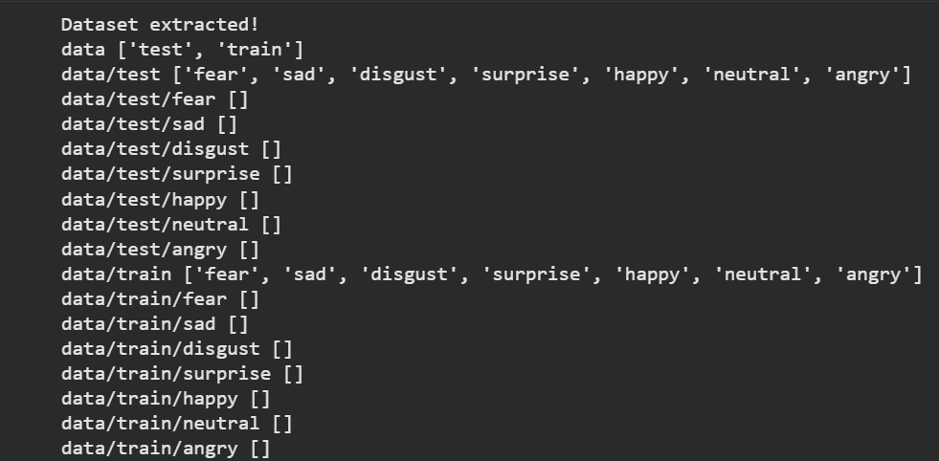
DATaset
•35,887 grayscale facial images
•Image size: 48 × 48 pixels
•Seven emotion classes
•Angry
•Disgust
•Fear
•Happy
•Sad
•Surprise
•Neutral

Slide 6

PReprocessing
•Image resizing and normalization
•Random horizontal flipping
•Split
•Improves generalization and reduces overfitting

Slide 7
Methodology
•Transfer learning approach
•Pretrained ResNet-18 model
•Final layer modified for 7 classes
•Implemented using PyTorch

Slide 8
Model Architecture (ResNet-18)
•18-layer deep convolutional neural network
•Residual connections reduce vanishing gradient
•Pretrained on ImageNet
•Strong feature extraction capability

Slide 9
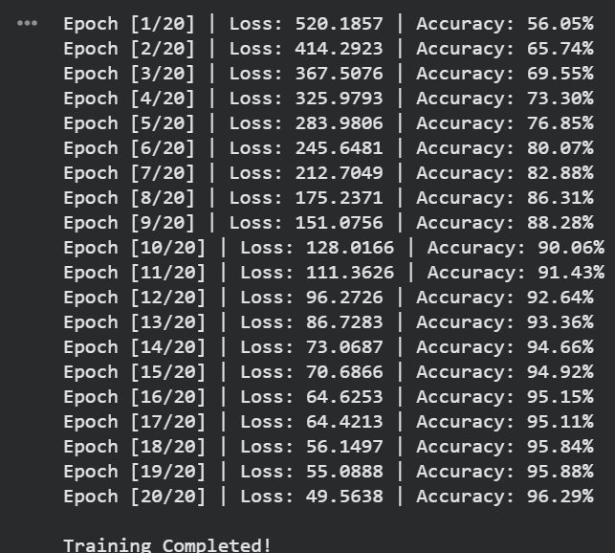
Training Process
•Loss Function: Cross-Entropy Loss
•Optimizer: Adam / SGD
•Training on GPU (if available)
•Validation using test dataset

Slide 10
Results & Evaluation
•Model accuracy evaluated on test data
•Confusion matrix for class-wise performance
•Happy and Neutral show higher accuracy
•Some confusion between Fear and Sad

Slide 11
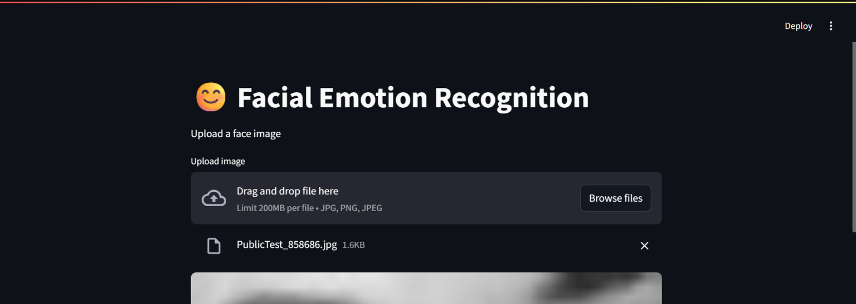
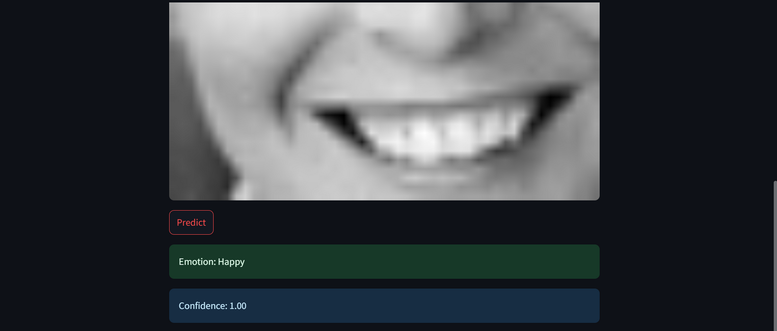
VISUalization
•Used Streamlit For the display.

Slide 12
CONCLUSion
•Deep learning effectively recognizes emotions
•ResNet-18 improves performance with transfer learning
•System is scalable and efficient
•Useful for real-world applications

Slide 13
FUture Scope
•Use deeper CNN architectures
•Apply facial alignment techniques
•Real-time emotion detection
•Deploy as a web or mobile application

Slide 14
Thank you!

